Slide 1
ER Modeling

Slide 2
Database system development Life Cycle
Database Planning
System Definition (specifying the scope and boundaries)
Requirement Collection and analysis
Database design
Implementation
Data conversion and loading
Testing
Operational maintenance

Slide 3
Phases of Database Design
1.
Conceptual Design
e.g ER Model
2.
Logical Design
e.g Relational Model
3.
Physical Design

Slide 4
ER Modeling
One of the most difficult aspect of database design is :
The fact that designers, programmers, and end-user tend to view data and its use in different ways
To ensure that we get a precise understanding of the nature of the data and how it is used by the enterprise, we need a model for communication that is non technical and free of ambiguities, the Entity-Relationship (ER)model is one of example.

Slide 5
ER Modeling (Cont.)
ER Modeling is a top-down approach to database design
Begin by identifying the important data called entities and relationship between the data that must be represented in the model
Then add some more details, such as:
The information we want to hold about the entities and relationship called attributes
Any constraint

Slide 6
Basic Concept of ER Modeling

Slide 7
Basic Concept of ER Modeling
Entities
Relationship
Attributes
Identifier
Multiplicity (cardinality and participation)

Slide 8
Entity
An entity is something that users want to track
Example:
Student
Course
Lecture

Slide 9
Attributes
Entities have attributes that describe the entity’s characteristics
Example:
Attributes for Student entity:
ID
Name
DoB
Class
Attributes for Course entity :
ID
Course Name

Slide 10
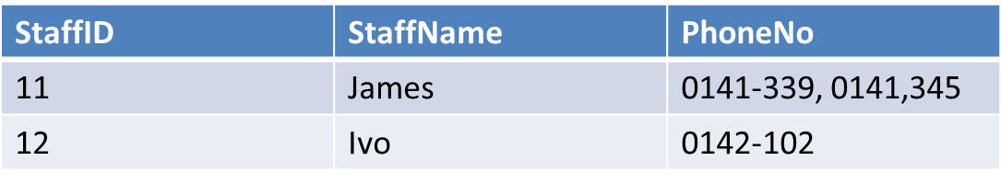
Attributes(Cont.)
Single-valued attribute : an attribute that holds a single value for each occurrence of an entity
Multi-valued attribute: an attribute that holds multiple value for each occurrence of an entity, example :
Derived-attribute : Can be computed from other attributes, example : Age

Slide 11
Identifiers
(Why?) Every instance of an entity must be uniquely identified
Entity: Student
Instances (Name attribute only):
John Smith, Jane Doe, John Smith, …
We need some attribute other than the Name to differentiate the first John Smith from the second John Smith
(What?) An identifier can be one attribute or a collection of attributes
One attribute as an identifier of the entity called STUDENT: student_no
A collection of attributes as an identifier of the entity called REGISTRATION: student_no +course_no
(How to denote an identifier) An underlined attribute (or a leading asterisk) denotes an identifier: student_no or * student_no

Slide 12
Relationship
Entities can be associated with one another in relationships.
Relationship is a set of meaningful associations among entity.
Relationship degree defines the number of entity classes participating in the relationship – Degree 2 is a binary relationship – Degree 3 is a ternary relationship

Slide 13
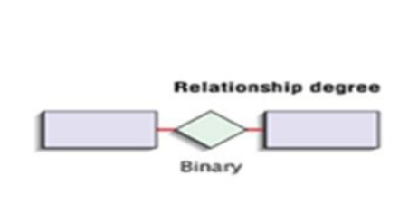
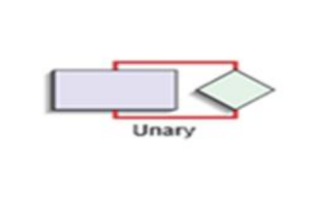
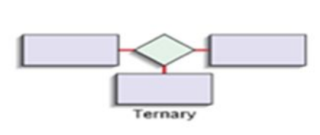
Relationship (Cont.)
Degree of Relationship

Slide 14
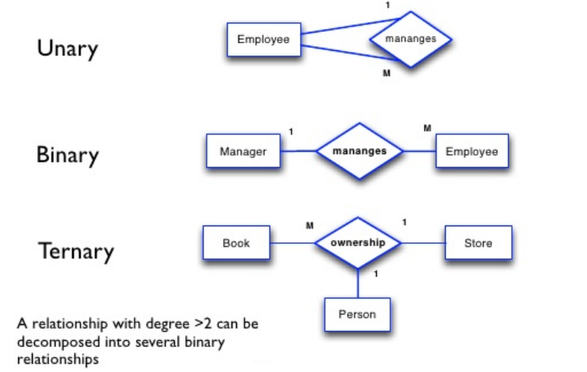
Relationship (Cont.)
Example of Degree of Relationship

Slide 15
Multiplicity (cardinality , participation)
Cardinality
describe the maximum number of possible relationship occurrence for an entity participating in a given relationship
Menunjukkan jumlah maksimum entitas yang dapat berelasi dengan entitas pada himpunan entitas yang lain
1 to 1 (one to one)
1 to N (One to many)
M to N (Many to many)
Participation
determines whether all or only some entity occurrences participate in a relationship. It appears on minimum values of the multiplicity
0 (optional participation)
1 (mandatory participation)

Slide 16
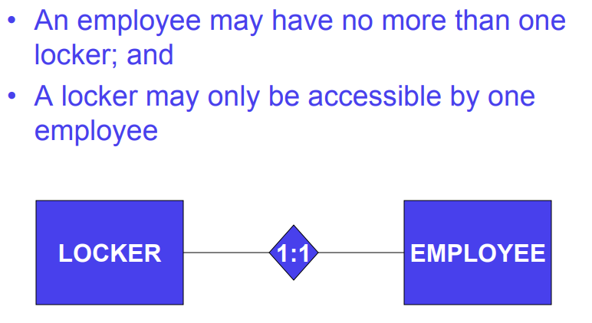
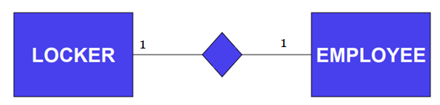
Example : One-to-one binary relationship

Slide 17
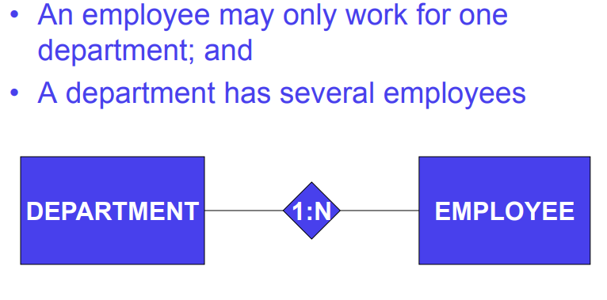
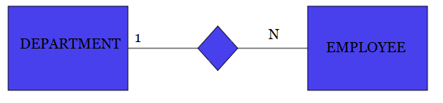
Example : One-to- many binary relationship

Slide 18
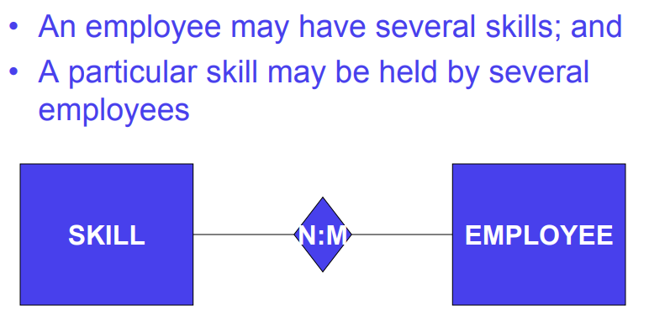
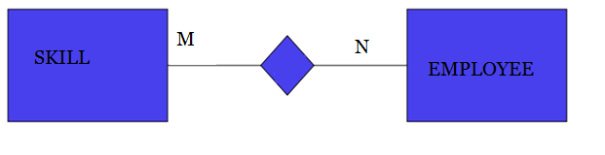
Example : many-to- many binary relationship

Slide 19
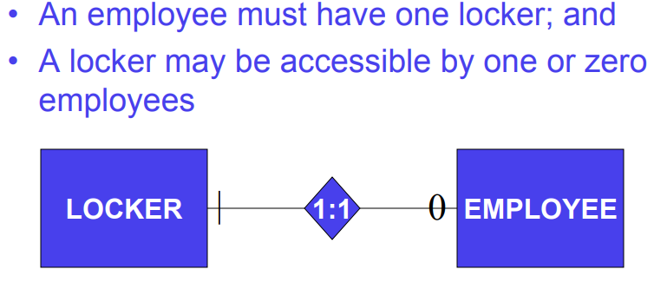
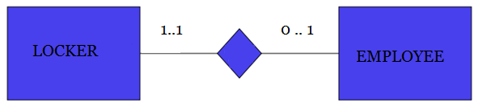
Example : One-to-one binary relationship with participation (minimum cardinality)

Slide 20
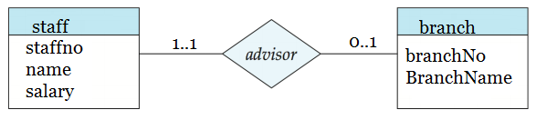
Example : One-to-one binary relationship with participation (minimum cardinality)
cardinality
One branch is managed by one member of staff
one member of staff managed one branch
All branches are managed
(mandatory participation for branch)
Not all staff manage branches
(optional participation for staff)
participation

Slide 21
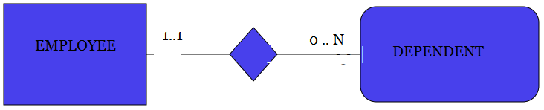
Weak Entity
A weak entity is an entity that cannot exist in the database without the existence on another entity
For example, an employee’s dependents cannot exist in a database without the employee existing in the database

Slide 22
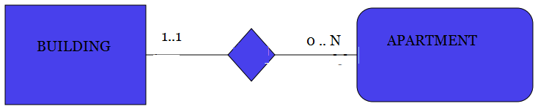
ID-Dependent Weak Entities
An ID-Dependent weak entity is a weak entity that must include the identifier of its parent entity as part of its composite primary key

Slide 23
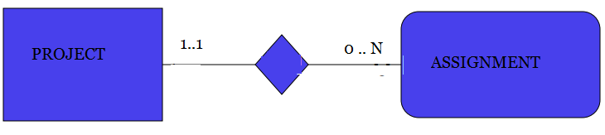
Weak Entity Identifier: ID-Dependent
An ID-dependent weak entity has a composite identifier
The first part of the identifier is the identifier for the strong entity
The second part of the identifier is the identifier for the weak entity itself

Slide 24
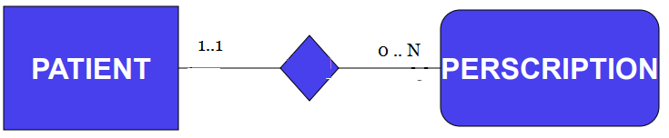
Weak Entity Identifier: Non-ID-dependent
A non-ID-dependent weak entity may have a single or composite identifier, and the identifier of the parent entity will be a foreign key

Slide 25
Weak Entity Relationships
The relationship between a strong and weak entity is termed an identifying relationship if the weak entity is ID-dependent
The relationship between a strong and weak entity is termed a nonidentifying relationship if the weak entity is non-ID-dependent

Slide 26
ER Model Notation

Slide 27
ER Modeling Notation
Diamond Notation (Chen)
Crow’s foot notation (Martin)
OMT-style notation (Rumbaugh)
Oracle Notation
UML Notation

Slide 28
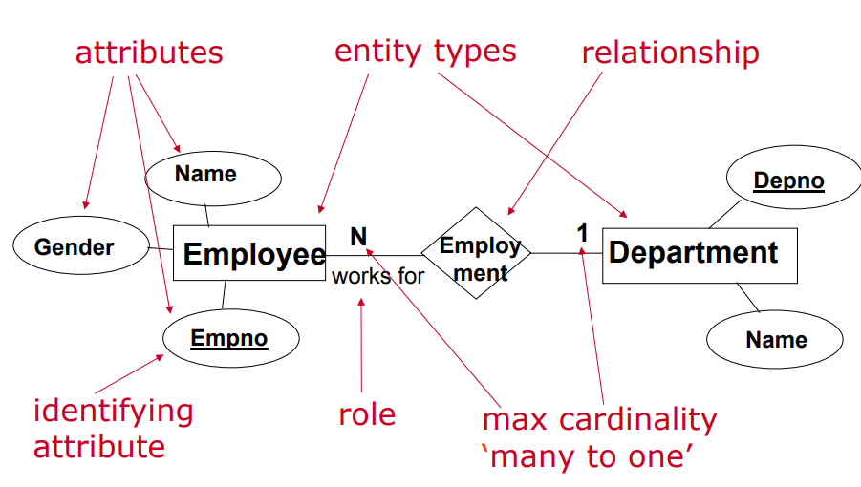
Diamond Notation (Chen)

Slide 29
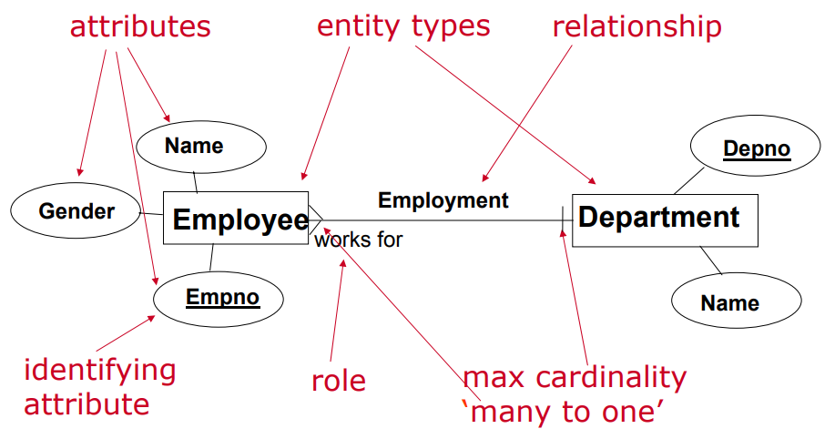
Crow’s foot notation (Martin)

Slide 30
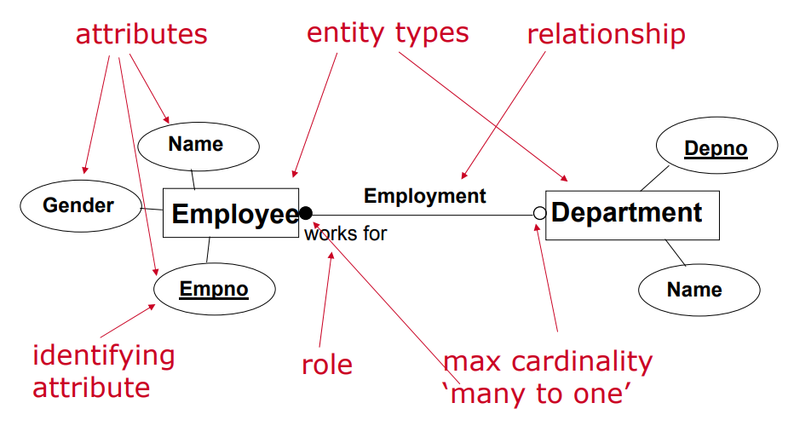
OMT-style notation (Rumbaugh)

Slide 31
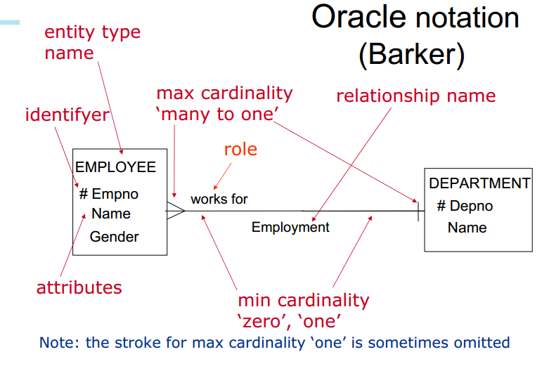

Slide 32
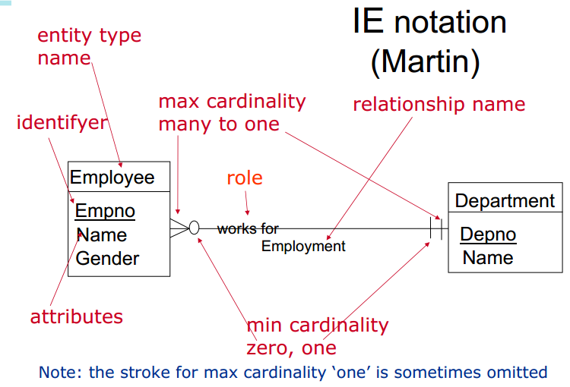

Slide 33
Exercise

Slide 34
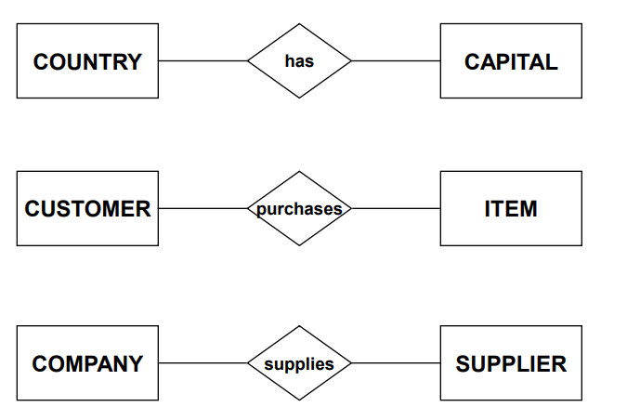
Exercise 1: Complete the relationship

Slide 35
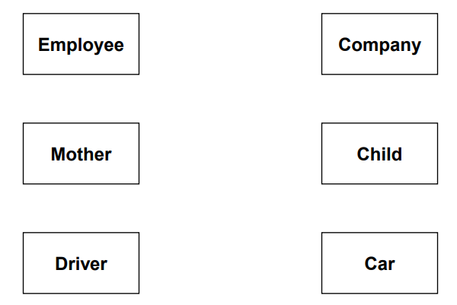
Exercise 2 : Complete the relationship

Slide 36
Exercise 3
Create an ER Model of the following description
A customer can place an order for one or more products. Customers that have not placed any orders can be included in the customer database for purposes of marketing research. Products that have not been ordered can be part of the product database. An order has to be associated with at least one product but can be associated with many products.

Slide 37
Exercise 4
Create an ER Model for each of the following description
Each company operates four departments and each department belongs to one company
Each department in part(a) employs one or more employees, and each employee works for one department
Each of the employee in part (b) may or may not have one or more dependents and each dependent belongs to one employee
Each employee in part (c)may or may not have an employment history
Represent all the ER model described in (a),(b),(c) and (d) as a single ER Model

Slide 38
Thank You ☺

